Slide 1
Physical description part 1
BODY - FACE

Slide 2
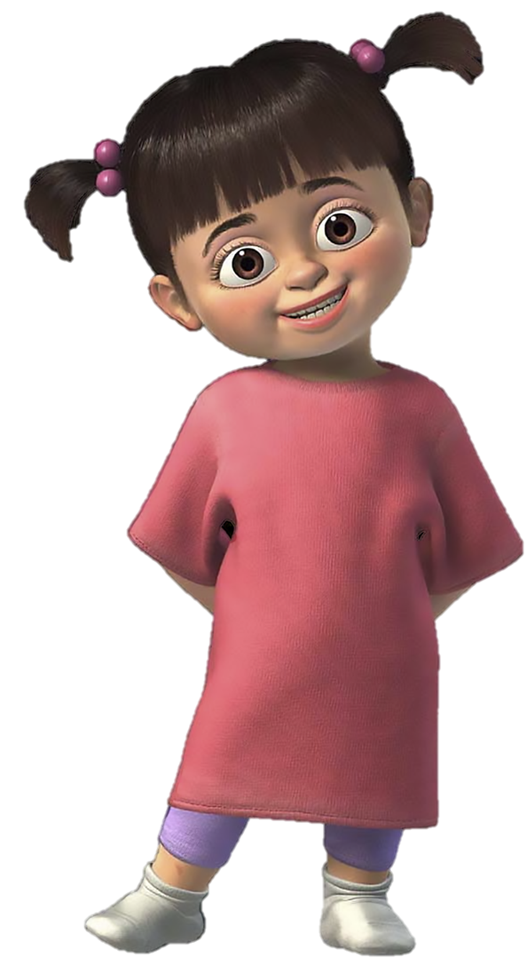
2
1
How many words do
already you know?
3
4
5
6
9
7
10
8

Slide 3
2
1
3
4
WORDS
a foot / two feet
an arm
a leg
an eye
Ø hair
a face
an ear
a head
a mouth
a tooth / teeth
5
6
9
7
10
Number 1 is …
8

Slide 4
2
ø hair
1
a head
an ear
3
4
an eye
a face
5
6
a mouth
9
a tooth / teeth
7
an arm
Now, you have 1 minute to remember these words
a leg
10
a foot / feet
8

Slide 5
2
ø hair
1
a head
an ear
3
4
an eye
a face
5
6
a mouth
9
a tooth / teeth
7
an arm
Let’s play !
a leg
10
a foot / feet
8

Slide 6
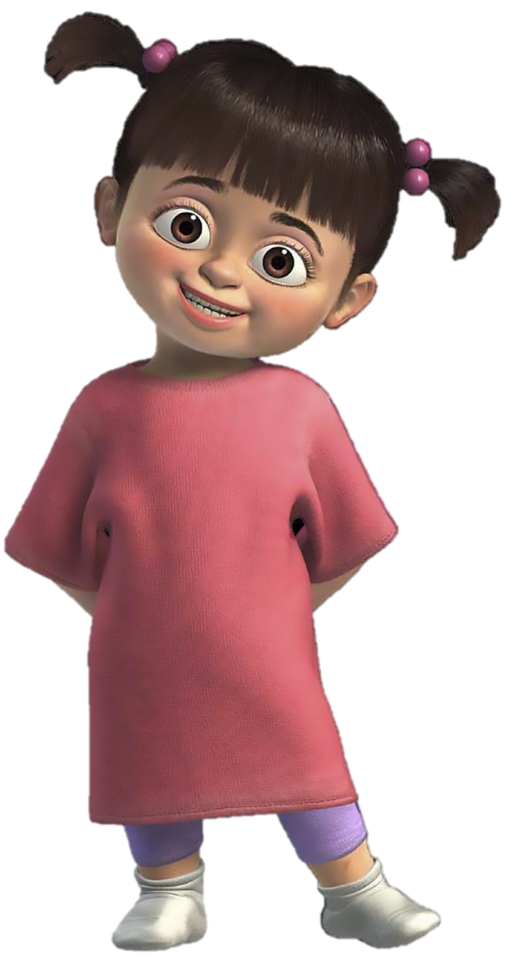
So, how many words do you
remember?
Excellent ! now you are ready to meet my friends…

Slide 7
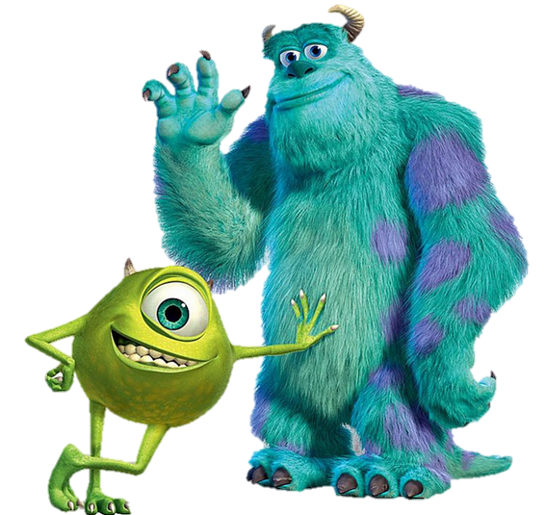
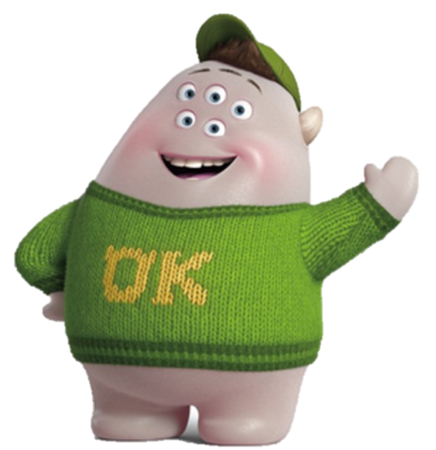
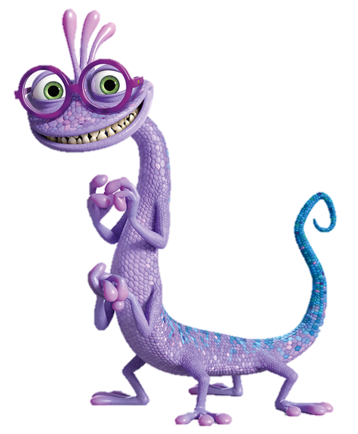
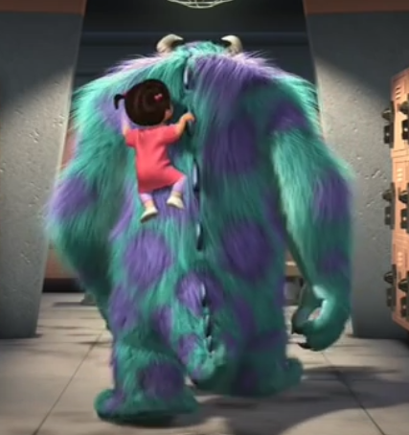
WORDS
fat
small
slim
tall
very
___m -- f____
s____ -- t____
Guess ?
v___ s____ -- ___y t____

Slide 8
slim -- fat
small -- tall
very small -- very tall

Slide 9
My Words
a foot / two feet
an arm
a leg
an eye
Ø hair
a face
an ear
a head
a mouth
a tooth / teeth
slim -- fat
small -- tall
very …… -- very ……

Slide 10
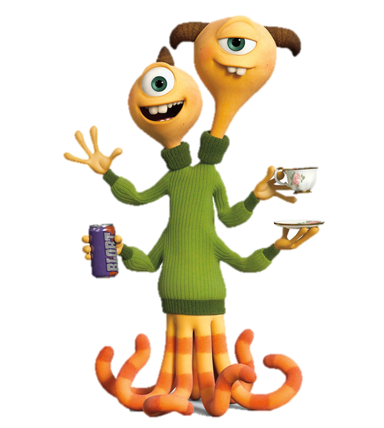
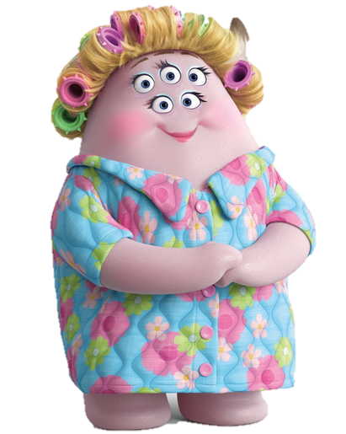
Now you are ready to describe
these characters!
She is …
She has got …
(She’s got)
She hasn’t got…
He is …
He has got …
(He’s got)
He hasn’t got…

Slide 11
She is …
She has got …
He is …
He has got …

Slide 12
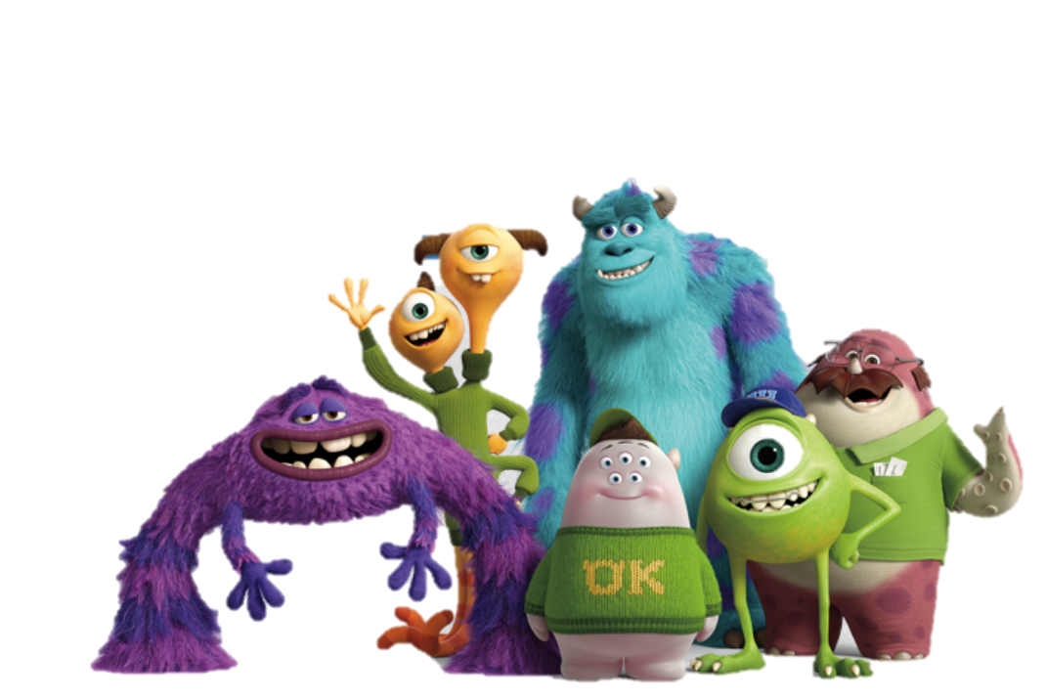
The blue monster is …
The _____ ______has got …
WORDS
a finger
ø braces
ø glasses
a moustache
a cap
a horn

Slide 13
Physical description part 2
CLOTHES
http://www.peanutizeme.com/

Slide 14
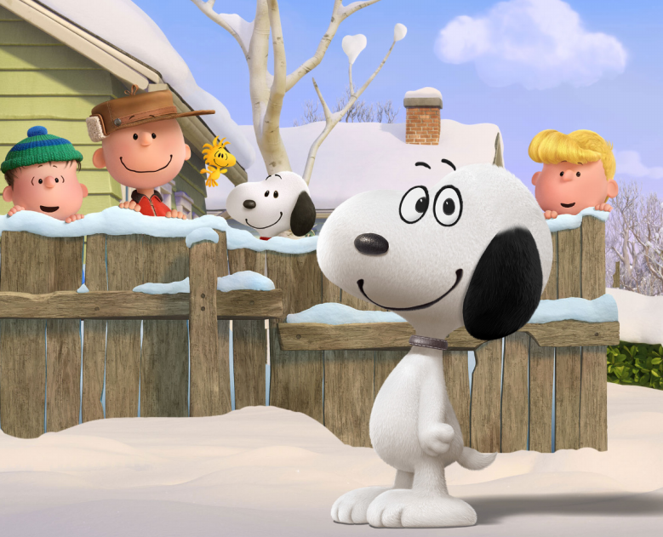
Let’s learn your
CLOTHES VOCABULARY
with my friends.
Remember as many words as possible in 2 minutes ...

Slide 15
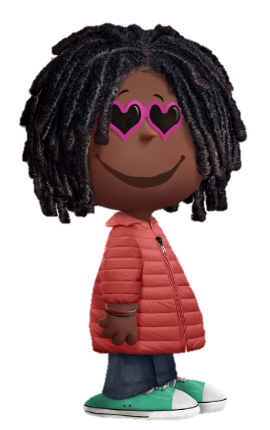
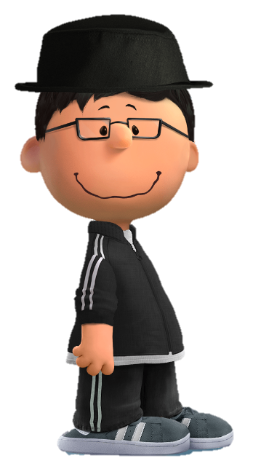
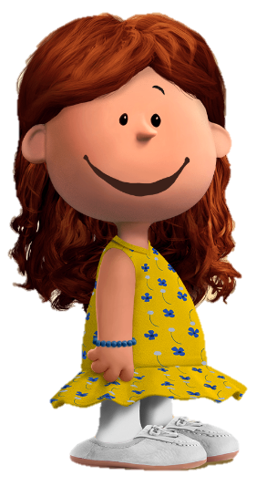
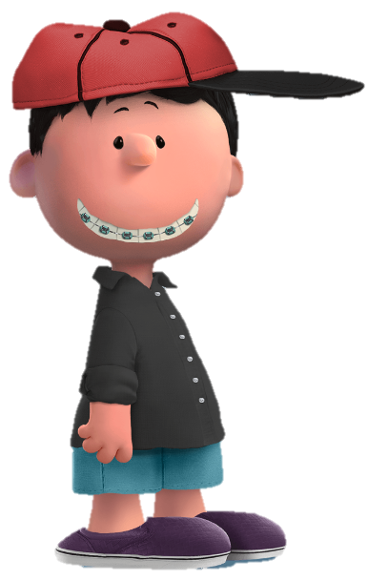
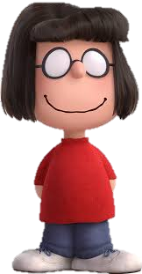
ø sunglasses
a hat
ø glasses
a coat
a dress
a tracksuit
a bracelet
a jacket
ø socks
ø jeans
a cap
ø shoes
ø braces
a shirt
a T-shirt
ø trousers/pants
ø shorts
ø trainers / sneakers
ø sandals

Slide 16
a cap
ø trousers
a shirt
ø sandals
ø braces
ø shorts
ø shoes
a T-shirt
Let’s play !

Slide 17
Let’s play !
a hat
ø glasses
a dress
ø trainers
a jacket
ø shoes
ø sunglasses
a tracksuit
ø jeans
a coat
ø socks
a bracelet

Slide 18
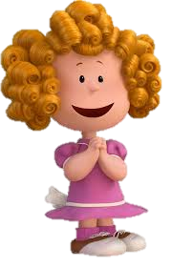
How many words can you remember.
Try to complete this chart.
Clothes | Shoes | Accessories

Slide 19
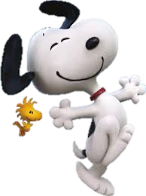
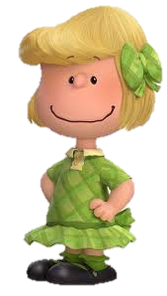
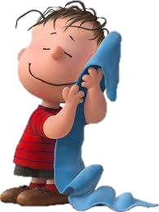
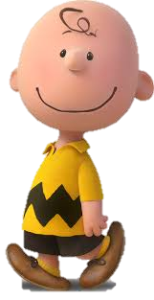
Now it’s time to practise and
describe my friends
She is …
She has got …
Marcie
He is …
He has got …
Frieda
Linus
Charlie Brown
Patty

Slide 20
WORDS
Ø shorts
Ø trousers
A dress
A T-shirt
A polo-shirt
Ø shoes
Ø trainers
Ø socks
Frieda
Linus
Marcie
Patty
Snoopy
Charlie Brown

Slide 21
a foot / two feet
an arm
a leg
an eye
Ø hair
a face
an ear
a head
a mouth
a tooth / teeth
My Words
ø shorts
ø trousers
ø jeans
a dress
a T-shirt
a shirt
a polo-shirt
a coat
a jacket
ø shoes
ø trainers
ø sandals
ø socks
slim -- fat
a cap
a hat
ø braces
ø glasses
ø sunglasses
small -- tall
very …… -- very ……

Slide 22
Physical description
Part 3
OPINION

Slide 23
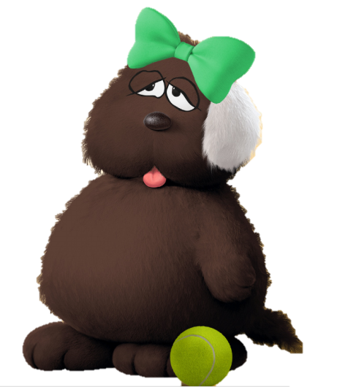
Can you COMPLETE this sentence to describe Shelly, my cousin?
This dog is fat and ________, she has got ø _______ ______ eyes and ø ________ _______ ears. She hasn’t got _____ ears.
She has got a very _______ ________ nose.
She has got a ___________ ________green bow.
I think she likes ________.
WORDS
beautiful = lovely
happy$≠$angry
funny, short
strange, ridiculous
Shelly

Slide 24
Charlie Brown is my best friend, he is really funny! What do you think of Shelly?
This dog is fat and brown, she has got ø funny black eyes and ø lovely white ears. She hasn’t got short ears.
She has got a very small black nose. She has got a ridiculous big green bow.
I think she likes tennis.
WORDS
beautiful = lovely
happy$≠$angry
funny, short
strange
ridiculous
Shelly

Slide 25
Can you COMPLETE this sentence too!
Frieda is a _________ _________girl.
She has got ø _____ ________ _______ blond hair.
She has got a ________ _______ dress and ø white and _______ shoes with ø _________ socks
I don’t like her dress! It’s really _____________.
WORDS
beautiful = lovely
happy$≠$angry
funny
strange
ridiculous

Slide 26
Charlie Brown is my best friend, he is really funny!
Frieda is a beautiful small girl.
She has got ø ugly short curly blond hair
She has got a strange pink dress and ø white and brown shoes with pink socks.
I don’t like her dress! It is really ridiculous!

Slide 27
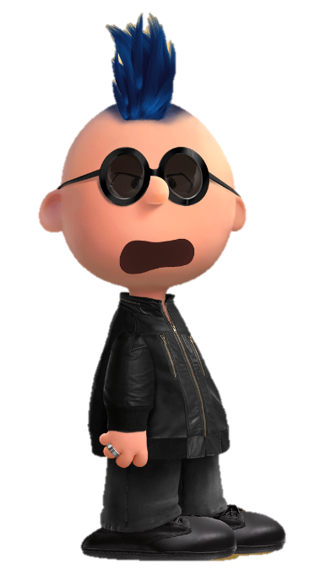
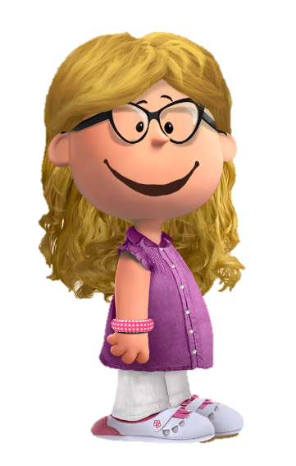
Snoopy is my best friend, he is really nice!
What do you think of Tom and Lucy!
Tom is
WORDS
beautiful
= lovely
happy
$≠$angry
funny
strange
ridiculous
Lucy is

Slide 28
My Words
a foot / two feet
an arm
a leg
an eye
Ø hair
a face
an ear
a head
a mouth
a tooth / ø teeth
ø shorts
ø trousers
ø jeans
ø shorts
a dress
a T-shirt
a shirt
a polo-shirt
a coat
a jacket
ø shoes
ø trainers
ø sandals
ø socks
a cap
a hat
ø braces
ø glasses
ø sunglasses
slim -- fat
beautiful = lovely
happy$≠$angry
funny
strange
ridiculous
small -- tall
very …… -- very ……

Slide 29
GOOD JOB !
GOOD JOB !
GOOD JOB !

